Slide 1
EzFinance
Object Oriented Computing Course Project
Daniel Kraemer

Slide 2
Problem Statement
Needed an app that had unique features to meet my needs for ensuring safe budgeting and use of my income.

Slide 3
Scenario
I wanted to create a program that manages my personal finances.
managing your finances can be a lot and cause a lot of stress.
This program would contain features such as being able to count and manage sources of income, total income, be able to provide a budget system, amount of spending per month, etc.
This program will be used on a daily basis for most users, and can be used as a tool for helping to be more organized and be on top of one's finances.

Slide 4
functionality
EzFinance was created solely by me
EzFinance uses data stored by the user to calculate budgets and total income by monthly. It takes the difference between income and budgets to give you a number that represents your leftover funds after tax.
Used suggestions from classmates to improve the system

Slide 5
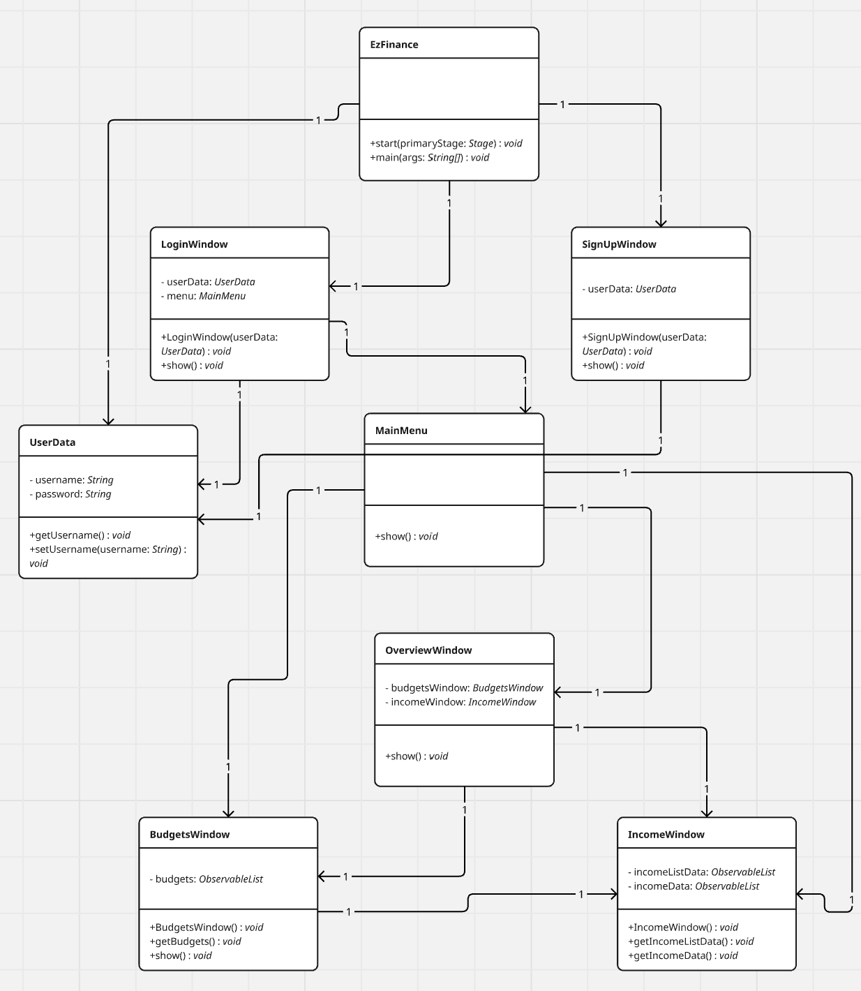
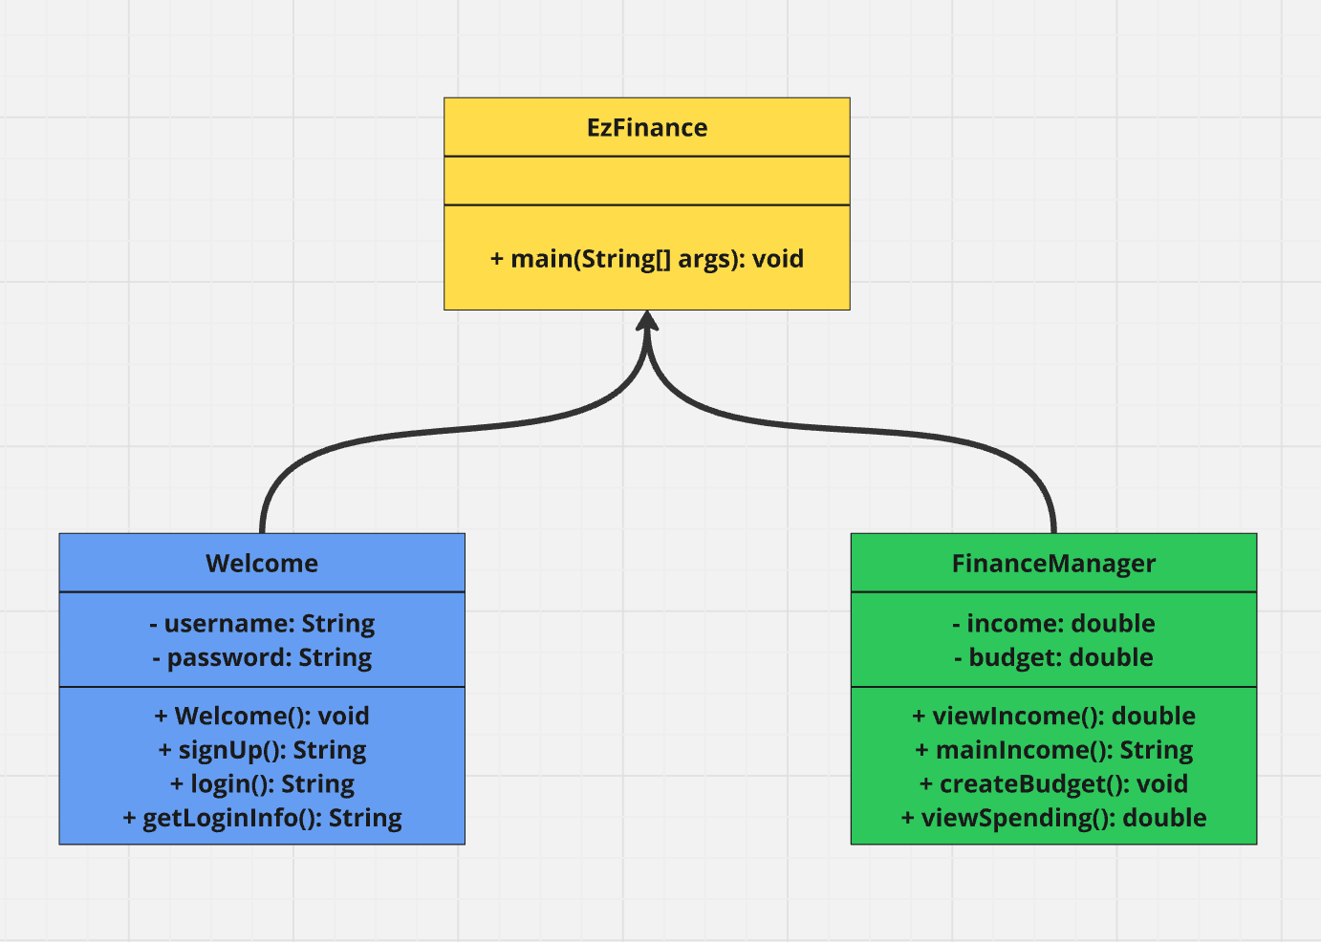
UML
(absolute mess)
original
new

Slide 6
Challenges
Saving user data after user closes the program
Creating the input tables for budgets and income

Slide 7
What I learned
Making calculations and using JavaFX to create a useful program that I will be using in the future.
Saving user data in a program
Coding style and work process.

Slide 8
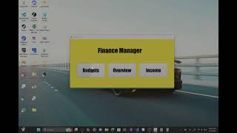
Demo
Demo

Slide 9
Thank you.

